Slide 1
1. List Data Structure

Slide 2
Objectives
Describe List structures
Describe self-referential structures
Explain types of linked lists
Singly Linked Lists
Circular Lists
Doubly Linked Lists
Lists in java.util

Slide 3
List Data Structures
A list is a sequential data structure, i.e. it is a sequence of items of a given base type, where items can be added, deleted, and retrieved from any position in the list.
A list can be implemented as an array, or as a dynamic array to avoid imposing a maximum size.
An alternative implementation is a linked list, where the items are stored in nodes that are linked together with pointers.
These two implementations have very different characteristics.
The possible values of this type are sequences of items of type BaseType (including the sequence of length zero). The operations of the ADT are:
getFirst(), getLast(), getNext(p), getPrev(p), get(p), set(p,x), insert(p,x), remove(p),removeFirst(), removeLast(), removeNext(p), removePrev(p), find(x),size()
Notes:
RMIT Vietnam
COSC2082 - Programming 2

Slide 4
Drawbacks of Arrays
Array is a very useful data structure in many situations. However, it has some important limitations:
They require size information for creation
Inserting an element in the middle of an array leads to moving other elements around
Deleting an element from the middle of an array leads to moving other elements around
Other data structures are more efficient in such situations.

Slide 5
Self-Referential Structures
Many dynamic data structures are implemented through the use of a self-referential structure.
A self-referential structure is an object, one of whose elements is a reference to another object of its own type.
With this arrangement, it is possible to create ‘chains’ of data of varying forms:
Employee
String name;
int age;
Linked lists
trees
DataNode
DataNode
Employee info;
DataNode next;
Employee info;
DataNode left;
DataNode right;
Self-Referential Structures
Notes:
RMIT Vietnam
COSC2082 - Programming 2

Slide 6
Linked Lists
A linked structure is a collection of nodes storing data and links to other nodes
A linked list is a linear data structure composed of nodes, each node holding some information and a reference to another node in the list
Types of linked lists:
Singly-Linked List
Doubly-Linked List
In programming, linear means that they are described by one (single) series of data … ie. Each data item has at most one predecessor and at most one successor. And, Non-linear means anything else.
Linear are – Array, Linked List, Stack, Queue. Non Linear are – Tree, Graph

Slide 7
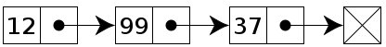
Singly Linked Lists
A singly linked list is a list whose node includes two data fields: info and next. The info field is used to store information, and this is important to the user. The next field is used to link to its successor in this sequence
The following image depicts a simple integer linked list.
info
next
head
tail
Singly Linked List

Slide 8
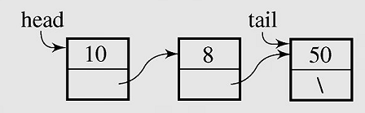
Singly Linked List Implementation
class Node
{int info;
Node next;
Node() {}
Node(int x, Node p)
{info=x;next=p;
}
}
class MyList
{Node head,tail;
MyList() {head=tail=null;}
boolean isEmpty()
{return(head==null);
}
void clear()
{head=tail=null;
}
void add(int x)
{ if(isEmpty())
head=tail=new Node(x,null);
else
{Node q =new Node(x,null);
tail.next=q; tail=q;
}
}
void traverse()
{Node p=head;
while(p!=null)
{System.out.print(" " + p.info);
p=p.next;
}
System.out.println();
}
Node search(int x) {...}
void dele(int x) {...}
}

Slide 9
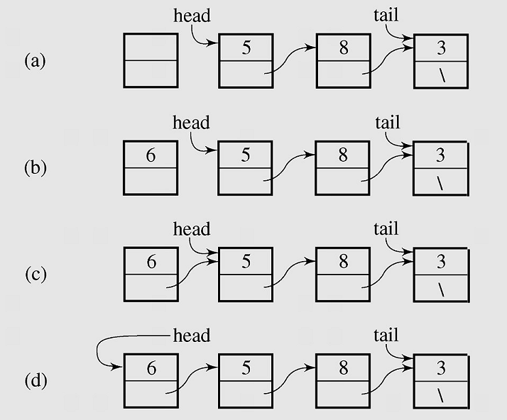
Singly Linked Lists - 1
Inserting a new node at the beginning of a list
Inserting a new node at the beginning of a Singly Linked List
Notes:
Image source: Drozdek

Slide 10
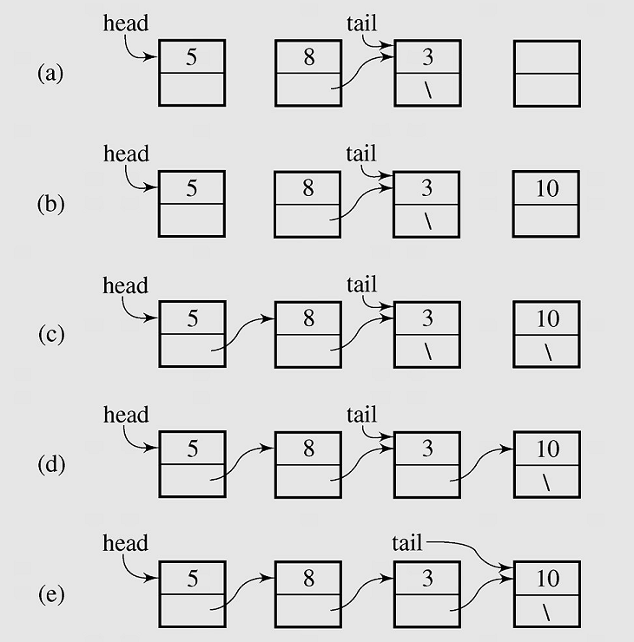
Singly Linked Lists - 2
Inserting a new node at the end of a list
Inserting a new node at the end of a Singly Linked List

Slide 11
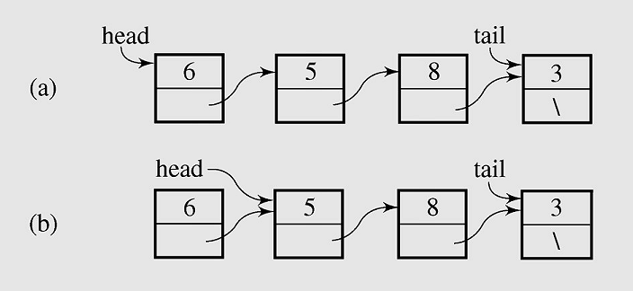
Singly Linked Lists - 3 Deleting a node from the beginning of a list
Deleting a node from the beginning of a Singly Linked List

Slide 12
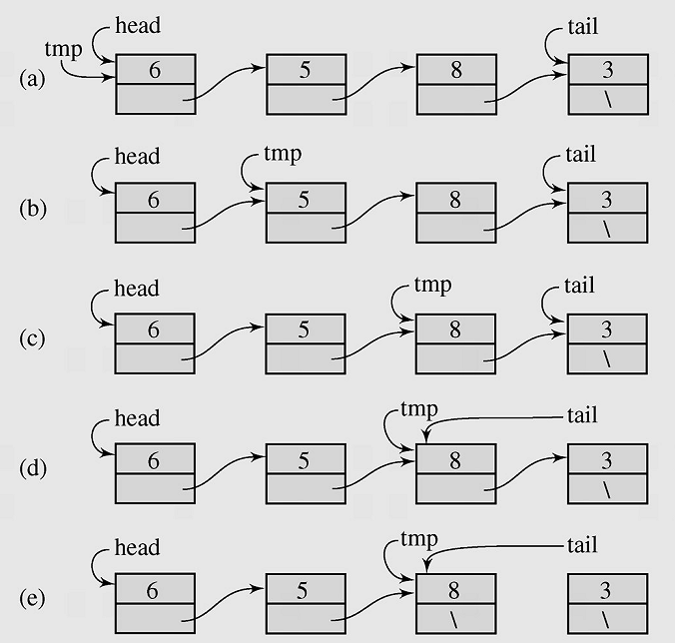
Singly Linked List - 4 Deleting element from the end of a list
Deleting a node from the end of a Singly Linked List

Slide 13
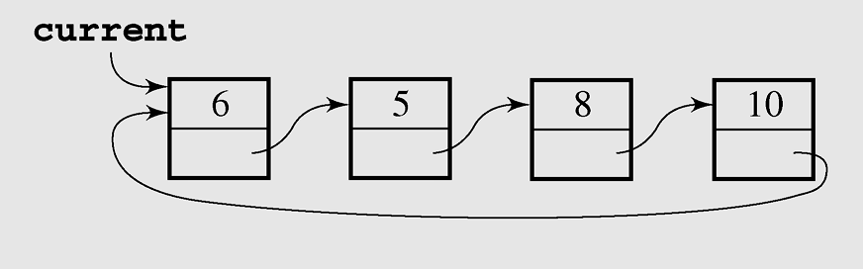
Circular Lists - 1
A circular list is when nodes form a ring: The list is finite and each node has a successor
Circular Singly Linked List

Slide 14
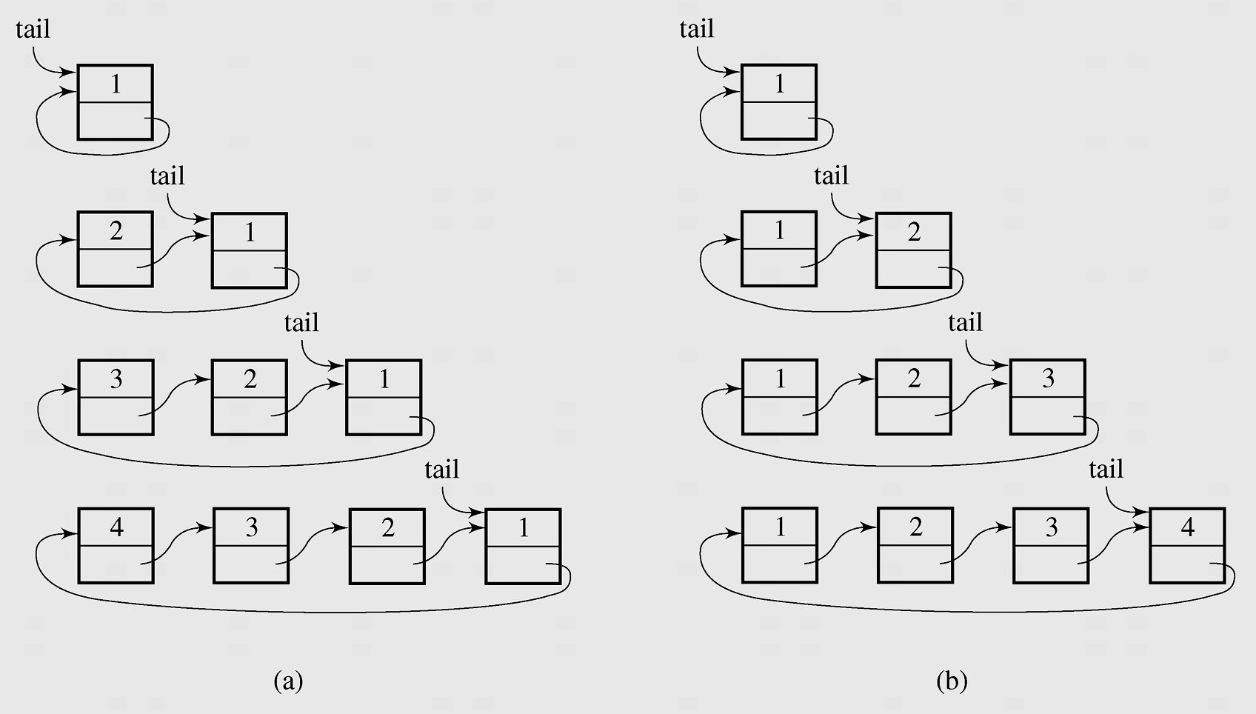
Circular Lists - 2 Inserting nodes
Inserting nodes at the front of a circular singly linked list (a) and at its end (b)

Slide 15
Circular List application
1. Round-Robin Scheduling
One of the most important roles of an operating system is in managing the many processes that are currently active on a computer, including the scheduling of those processes on one or more central processing units (CPUs).
In order to support the responsiveness of an arbitrary number of concurrent processes, most operating systems allow processes to effectively share use of the CPUs, using some form of an algorithm known as round-robin scheduling.
A process is given a short turn to execute, known as a time slice, but it is interrupted when the slice ends, even if its job is not yet complete. Each active process is given its own time slice, taking turns in a cyclic order.

Slide 16
Circular List application
2. Using circular linked list to implement Round-Robin Scheduling
We can use circular linked list to implement Round-Robin Scheduling by the following method: rotate( ): Moves the first element to the end of the list.
With this new operation, round-robin scheduling can be efficiently implemented by repeatedly performing the following steps on a circularly linked list C:
1. Give a time slice to process C.first( )
2. C.rotate( )

Slide 17
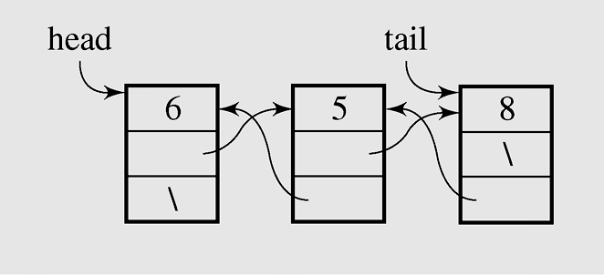
Doubly Linked Lists - 1
In a doubly linked list, each node has two reference fields, one to the successor and one to the predecessor
class MyList
{Node head,tail;
MyList() {head=tail=null;}
boolean isEmpty()
{return(head==null); }
void clear() {head=tail=null;}
void add(int x)
{if(isEmpty())
head=tail=new Node(x,null,null);
else
{Node q =new Node(x,tail,null);
tail.next=q;
tail=q;
}
}
...
}
Doubly Linked List
class Node
{int info;
Node prev,next;
Node() {}
Node(int x, Node p, Node q)
{info=x;prev=p; next=q;
}
}
Notes:
Image Source: Drozdek

Slide 18
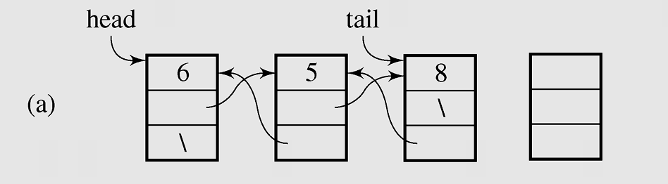
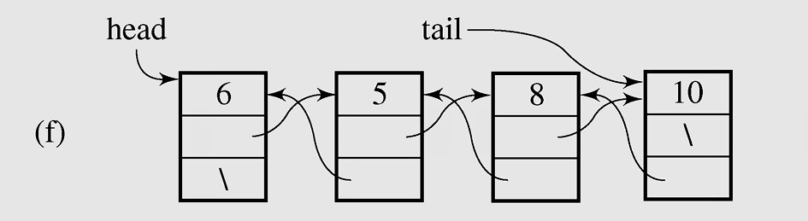
Doubly Linked Lists - 2 Adding a new node at the end
Adding new node at the end of Doubly Linked List

Slide 19
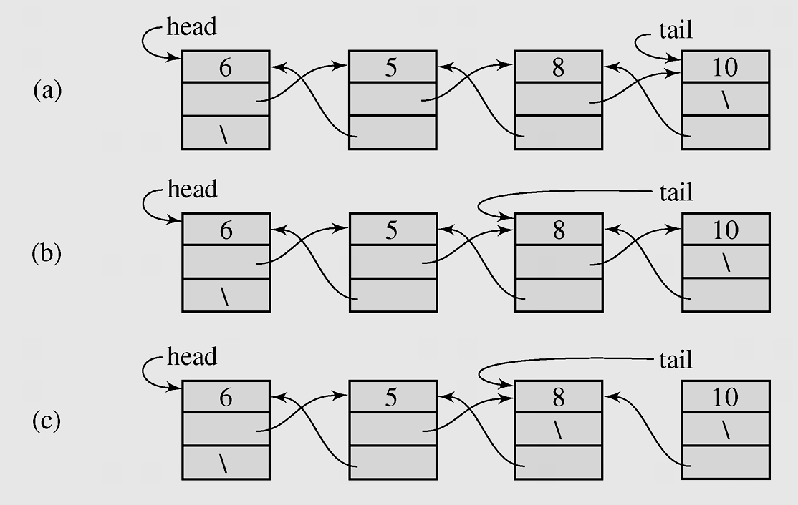
Doubly Linked Lists -3 Deleting a node from the end
Deleting a node from the end of Doubly Linked List

Slide 20
Lists in java.util - LinkedList class
boolean | add(E o) Appends the specified element to the end of this list.
void | addFirst(E o) Inserts the given element at the beginning of this list.
void | addLast(E o) Appends the given element to the end of this list.
void | clear() Removes all of the elements from this list.
E | get(int index) Returns the element at the specified position in this list.
E | getFirst() Returns the first element in this list.
E | getLast() Returns the last element in this list.
E | remove(int index) Removes the element at the specified position in this list.
E | removeFirst()Removes and returns the first element from this list.
E | removeLast() Removes and returns the last element from this list.
int | size() Returns the number of elements in this list.
Object[] | toArray() Returns an array containing all of the elements in this list in the correct order.

Slide 21
Lists in java.util LinkedList class example
import java.util.*;
class Node
{ String name;
int age;
Node() {}
Node(String name1, int age1)
{ name=name1; age=age1;
}
void set(String name1, int age1)
{ name=name1; age=age1;
}
public String toString()
{ String s = name+" "+age;
return(s);
}
}
class Main
{
public static void main(String [] args)
{
LinkedList t = new LinkedList();
Node x; int n,i;
x = new Node("A01",25); t.add(x);
x = new Node("A02",23); t.add(x);
x = new Node("A03",21); t.add(x);
for(i=0;i<t.size();i++)
System.out.println(t.get(i));
}
}

Slide 22
Lists in java.util - ArrayList class
boolean | add(E o) Appends the specified element to the end of this list.
void | add(int index, E o) Inserts the given element at the specified pos.
void | clear() Removes all of the elements from this list.
E | get(int index) Returns the element at the specified position in this list.
E | remove(int index) Removes the element at the specified position in this list.
int | size() Returns the number of elements in this list.
void | ensureCapacity(int minCapacity) Increases the capacity of this ArrayList instance, if necessary, to ensure that it can hold at least the number of elements specified by the minimum capacity argument.
void | trimToSize() Trims the capacity of this ArrayList instance to be the list's current size.
Object[] | toArray() Returns an array containing all of the elements in this list in the correct order.

Slide 23
Exercise
Fill in the blank of the statement to form the most correct one:
In a ____ every element contains some data and a link to the next element, which allows to keep the structure.
A. binary search tree
B. doubly linked list
C. singly linked list
D. skip list

Slide 24
Exercise
Fill in the blank of the statement to form the most correct one:
In a ____ every element contains some data, a link to the next element and a link to the previous element, which allows to keep the structure.
A. binary search tree
B. doubly linked list
C. singly linked list
D. skip list

Slide 25
Exercise
Binary search algorithm cannot be applied to
A. sorted linear array
B. sorted doubly linked list
C. Binary search tree

Slide 26
Exercise
State True or False:
In a singly-linked list every element contains some data and a link to the next element, which allows to keep the structure.
A. True
B. False

Slide 27
Exercise
Select the most correct statement:
A. In a linked list, there must be the tail node.
B. The tail node is necessary for inserting a node before the last node
C. In a linked list, the tail node is introduced for performance purpose only
D. The tail node is necessary for inserting a node after the last node

Slide 28
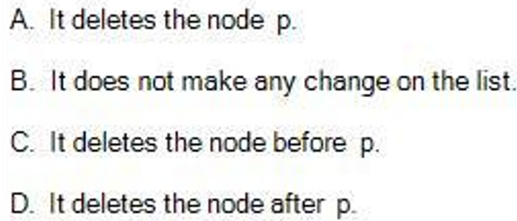
Exercise
Select the statement that is most correct.
Suppose we are considering a doubly linked list and p is some node in the list which has successor node
What does the java code snippet below do?
Node p1,p2; p1 = p.next;
p2=p1.next;
p.next = p2;
if(p2 != null) p2.prev=p;

Slide 29
Exercise
Select the statement that is most correct.
Suppose we are considering a doubly linked list and p is some node in the list which has successor node.
What does the java code snippet below do?
Node p1, p2;
p1 = new Node(x);
p2=p.next;
p.next = p1; p1.prev = p;
p1.next =p2; p2.prev= p1;
A. It inserts new node with value x after the node p.
B. It inserts new node with value x before the node p.
C. It replaces the node p with new node with value x.
D. It creates new node with value x at the end of the list.

Slide 30
Exercise
1. Suppose a doubly linked list of integers is given below and p is a reference to the node with value 13 in the list (i.e. p.info=13):
(head) 7 11 6 4 3 13 8 2 (tail)
What does the list look like after the following java code snippet is run?
int x = 9;
Node q = new Node(x);
q.prev=null;
q.next = head;
head.prev = q;
head = q;
2. Suppose a doubly linked list of integers is given below and p is a reference to the node with value 29 in the list (i.e. p.info=29):
(head) 17 11 6 4 3 29 8 2 (tail)
What does the list look like after the following java code snippet is run?
int x = 5;
Node p1, p2;
p1 = new Node(x);
p2 = p.next;
p.next = p1; p1.prev = p;
p1.next = p2; p2.prev = p1;

Slide 31
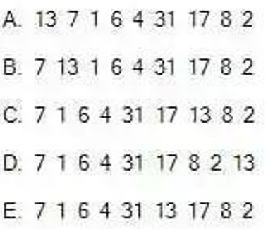
Exercise
Suppose a doubly linked list of integers is given below and p is a reference to the node with the list (i.e. p.info=17):
(head) 7 1 6 4 31 17 8 2 (tail)
What does the list look like after the following java code snippet is run?
int x = 13;
Node f = p.prev; //prev is a link to predecessor node
Node q = new Node(x);
q.prev = f; q.next = p;
f.next = q; p.prev = q;

Slide 32
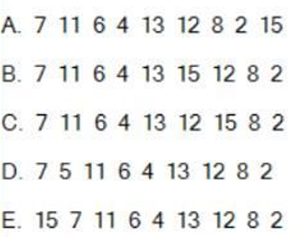
Exercise
Suppose a doubly linked list of integers is given below and p is a reference to the node with value 12 in the list (i.e. p.info=12):
(head) 7 11 6 4 13 12 8 2 (tail)
What does the list look like after the following java code snippet is run?
int x=15;
Node f = p.prev; //prev is a link to predecessor node
Node q = new Node(x);
q.prev = f; q.next = p;
f.next = q; p.prev = q;

Slide 33
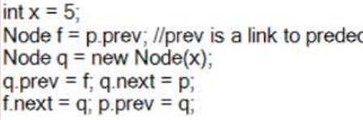

Exercise
Suppose a doubly linked list of integers is given below and p is a reference to the node with value 12 in the list (i.e. p.info=12):
(head) 7 11 6 4 3 12 8 2 (tail)
What does the list look like after the following java code snippet is run?

Slide 34
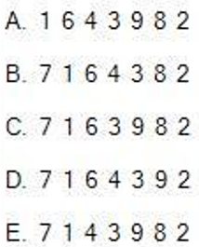
Exercise
Suppose a doubly linked list of integers is given below and p is a reference to the node list (i.e. p.info=3):
(head) 7 1 6 4 3 9 8 2 (tail)
What does the list look like after the following java code snippet is run?
Node p1, p2; p1 = p.next;
p2= p1.next;
p.next = p2;
if(p2 != null) p2.prev=p;

Slide 35
Exercise
Suppose a singly linked list of integers is given below and p is a reference to the node with value 9 in the list (i.e. p.info=9):
(head) 7 11 6 4 3 9 8 2 (tail)
What does the list look like after the following java code snippet is run?
int x = 5;
Node f = head;
while(f.next != p) f = f.next;
Node q = new Node(x);
q.next = p;
f.next = q;

Slide 36
Exercise
Suppose a singly linked list of integers is given below and p is a reference to the node with value 3 (i.e. p.info=3):
(head) 7 11 6 4 3 9 8 2 (tail)
What does the list look like after the following java code snippet is run?
int x = 5;
Node f = head;
while(f.next != p) f = f.next;
Node q = new Node(x);
q.next = p;
f.next = q;

Slide 37
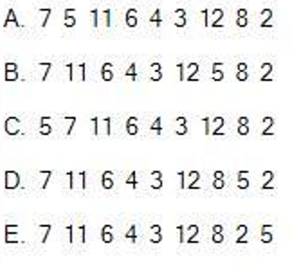
Exercise
Suppose a singly linked list of integers is given below:
(head) 7 11 6 4 3 12 8 2 (tail)
What does the list look like after the following java code snippet is run?
int x = 5;
Node f = head;
while(f.next != tail) f = f.next;
Node q = new Node(x);
q.next = tail;
f.next = q;

Slide 38
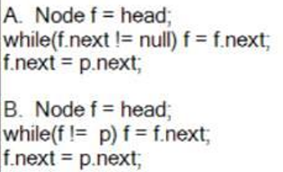
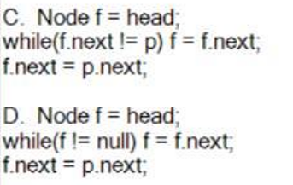
Exercise
Suppose we are considering a singly linked list and p is some node in the list which has both predecessor and successor nodes.
Select the most correct java code snippet that deletes the node p.

Slide 39
Exercise
Select the statement that is most correct.
Suppose we are considering a singly linked list which is not empty. What does the java code snippet below do?
Node q = new Node(x);
tail.next = q;
tail = q;

Slide 40
Exercise
Consider the fun() method in a singly linked list of integers below:
Integer fun()
{ if (isEmpty()) return null;
Integer x = head.info;
if (head == tail)
head = tail = null;
else head = head.next;
return(x);
}
Specify the correct statement about the fun() method in the code above (choose the most suitable one).
A. It removes and returns the first element of the list
B. It removes and returns the last element of the list
C. It removes and returns the second element of the list
D. It returns the first element of the list

Slide 41
Exercise
- Enter into the list: 12, 5, 100, 70, 30, 1
- Print the list to the screen
- Delete the first element in the list --> Print the list to the screen
- Delete the last element in the list --> Print the list to the screen
- Insert the number 40 at the first position (0th) of the list; 20 at the second position; 50 at the last position of the list --> Print the list to the screen
- Search for the element entered from the keyboard. If the element is in the list, print its position. Otherwise, if it does not exist, print the message "Not found".
- Sort the list in ascending order --> Print the list to the screen

Slide 42
Summary
A list is a sequential data structure, i.e. it is a sequence of items of a given base type.
A list can be implemented as an array, or as a dynamic array to avoid imposing a maximum size.
An alternative implementation is a linked list , where the items are stored in nodes that are linked together with pointers.
A singly linked list is when a node has a link to its successor (next node) only.
A circular list is when nodes form a ring: The list is finite and each node has a successor.
A doubly linked list is when a node has links to its previous and to the next nodes.

Slide 43
Reading at home
Text book: Data Structures and Algorithms in Java
3 Fundamental Data Structures 103
3.1 Using Arrays - . 104
3.2 Singly Linked Lists - 122
3.3 Circularly Linked Lists - 128
3.4 Doubly Linked Lists - 132

